Slide 1
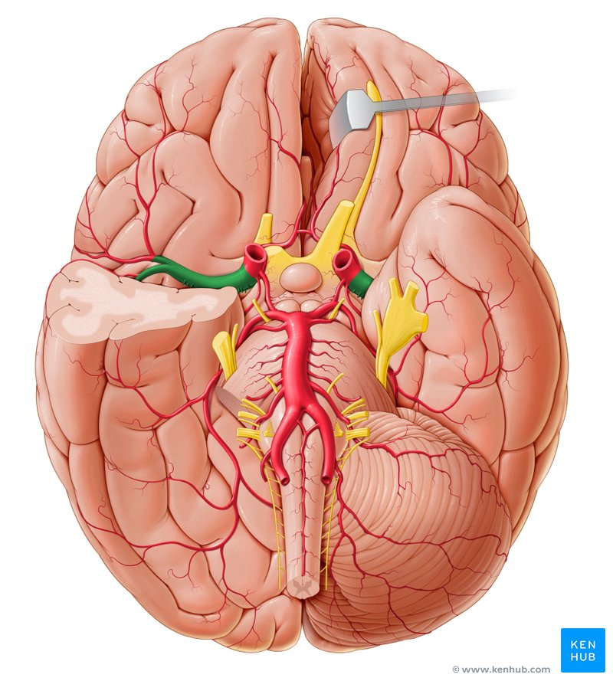
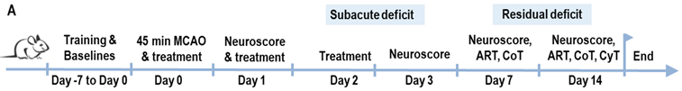

A new treatment for stroke
Treating stroke with a novel neuroprotective agent: JM-20
Stroke model: tMCAO (transient middle cerebral artery occlusion)
Sham condition
Outcome: Neurological Score (0-16)
Series of 4 experiments in Havanna and Berlin

